Slide 1
Migration of the high throughput microscopy dashboard
Wouter Jansema
Sequencing Analysis Support Core
Leiden

Slide 2
Agenda
Introduction
The old dashboard
Reason behind migration
New dashboard
Future direction
Questions

Slide 3
An introduction to high throughput microscopy

Slide 4
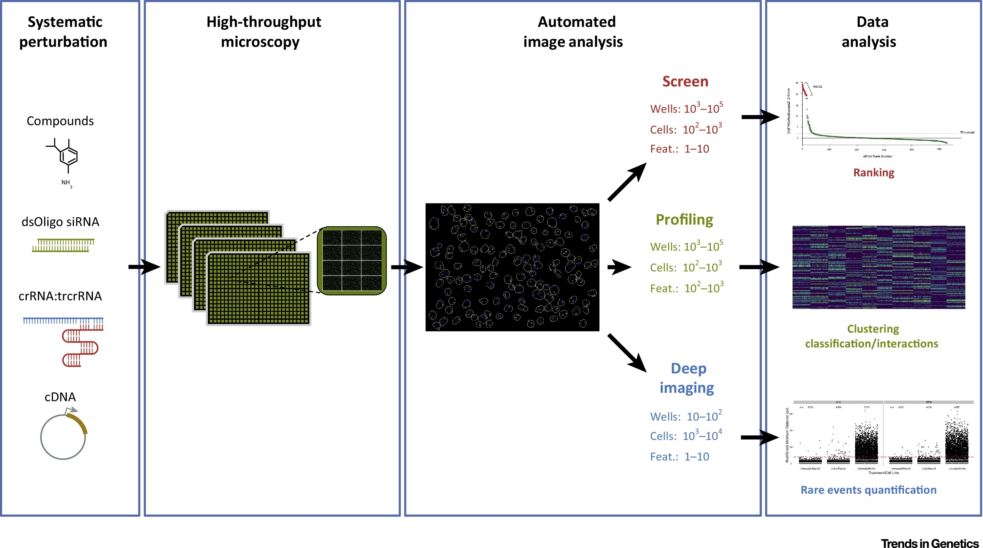
Overview

Slide 5
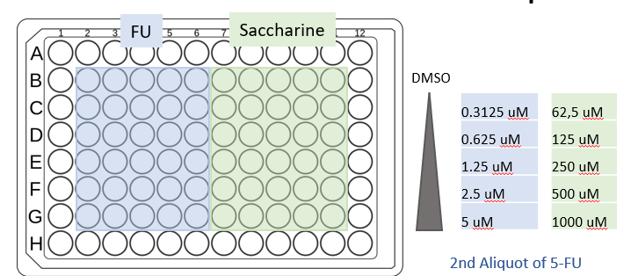
Typical experimental design
A plate where cells are grown under diverse media and conditions
How are conditions affecting the population of cells growing in each well?

Slide 6
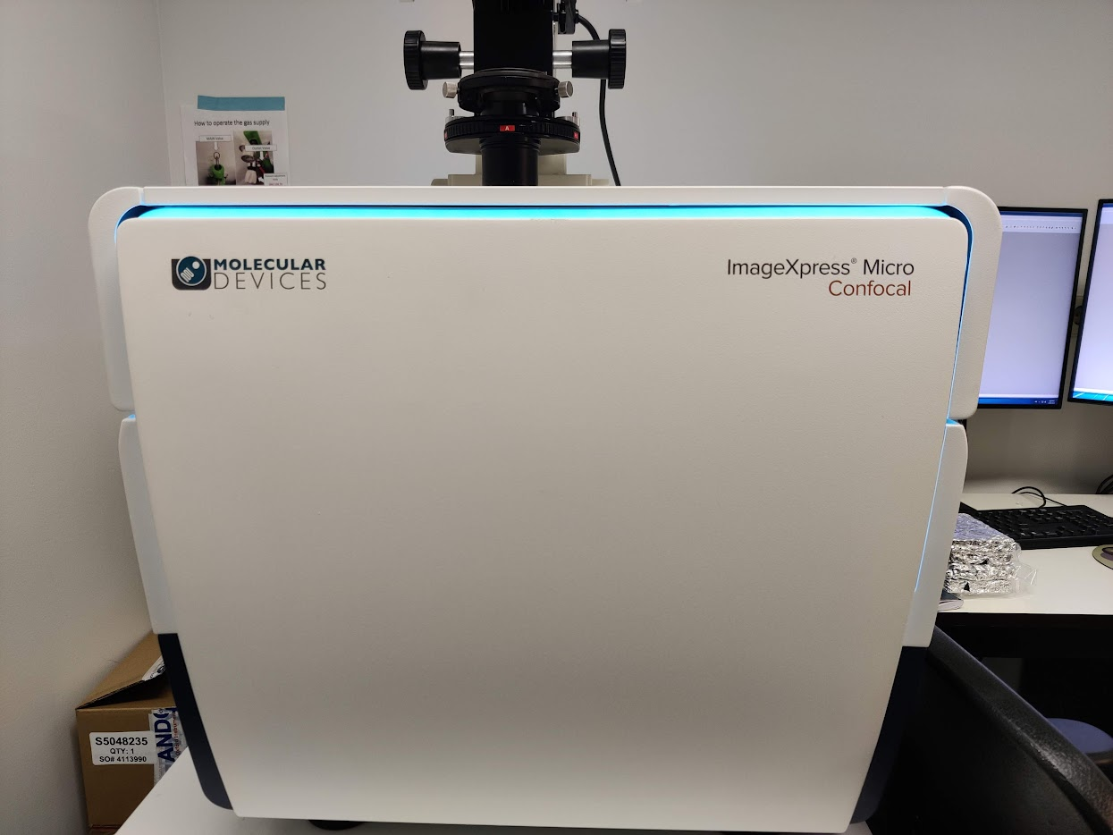
The machine
ImageXpress is producing images
Fluorescence from several channels is measured (DAPI, OCT4, SOX17)

Slide 7
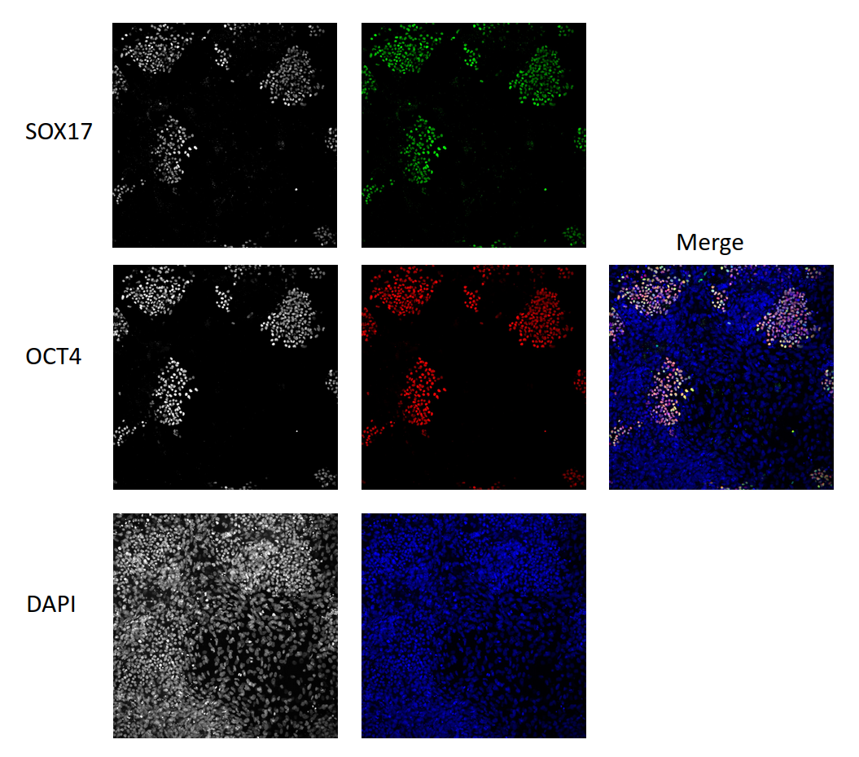
Image
DAPI indicates the presence of DNA, thus cell nucleus
On top of that measure presence of proteins of interest (OCT4, SOX17)

Slide 8
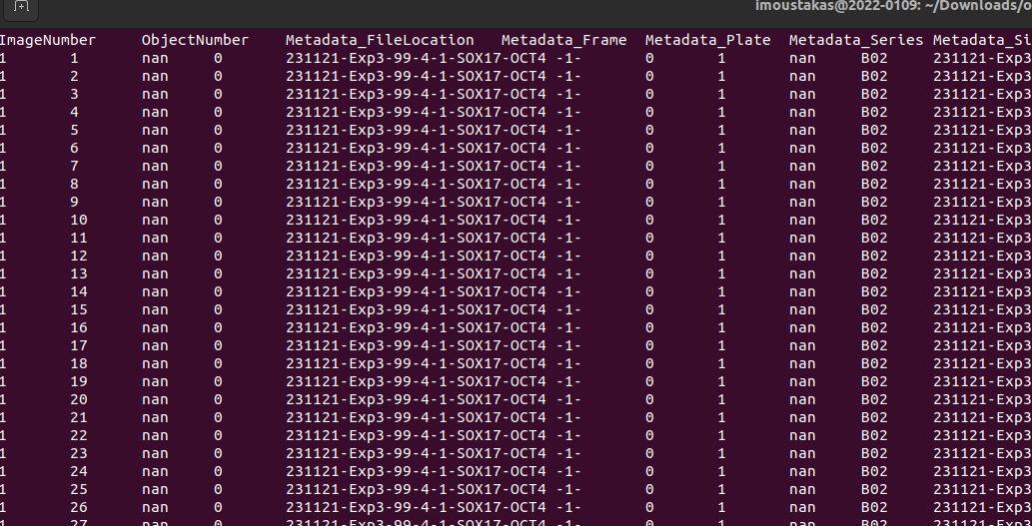
From image to data
Using an image analysis software, intensities of DAPI and proteins of interest (SOX17, OCT4) are estimated and registered in a large table
Has dozens of columns, typically half a million rows
Each row is a cell

Slide 9
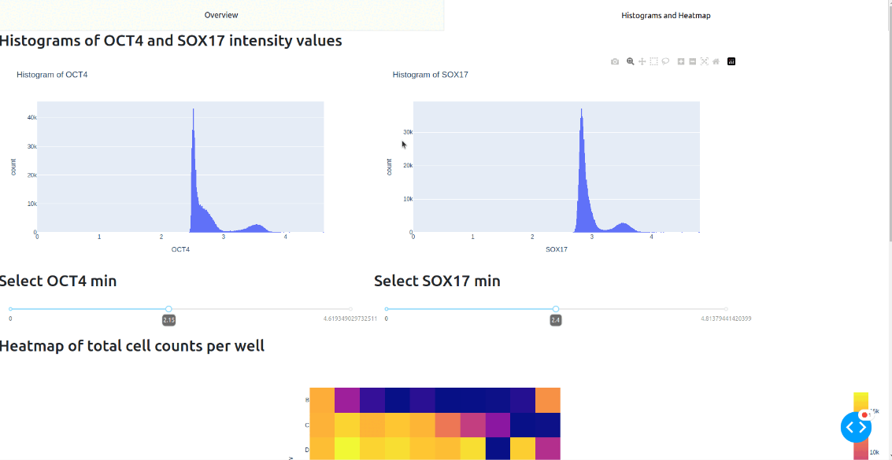
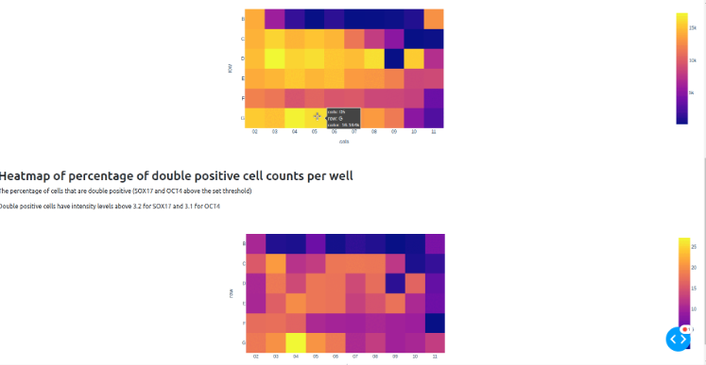
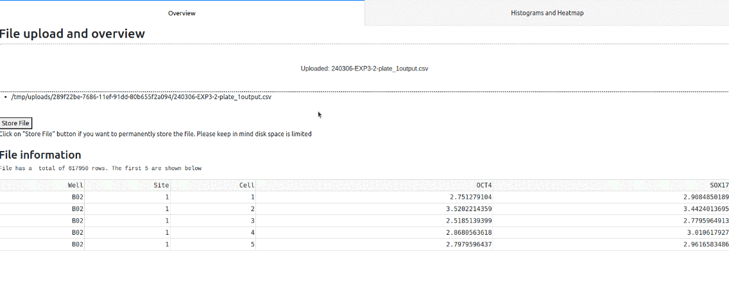
The old dashboard – what did it do
Takes a file as input
Displays some info
Displays 2 histograms
Selecting intensity
Heatmaps
counts
double positives

Slide 10
Reason behind migration
Add authentication
Support storing output
Slow
Easier to extend with new features
More professional appearance

Slide 11

Migration to Django
Why Django?
Python
Extensive documentation
Large community
Active development
Database integration
Built-in security
Easy to pick up

Slide 12

The new dashboard -

Slide 13
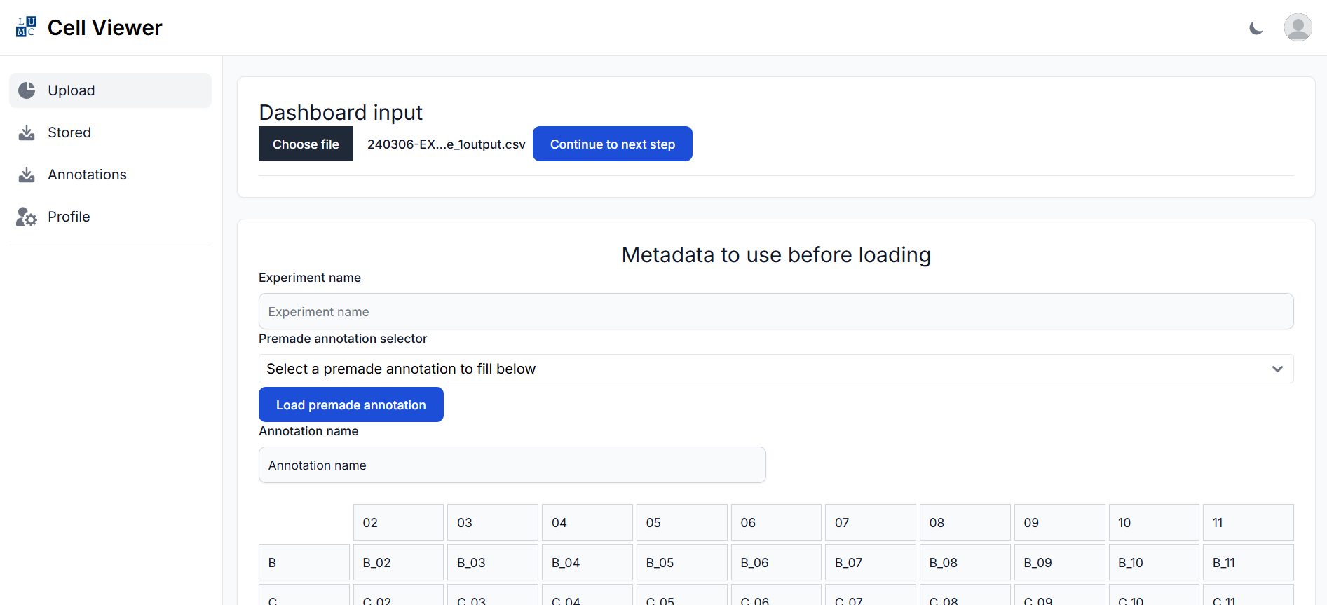
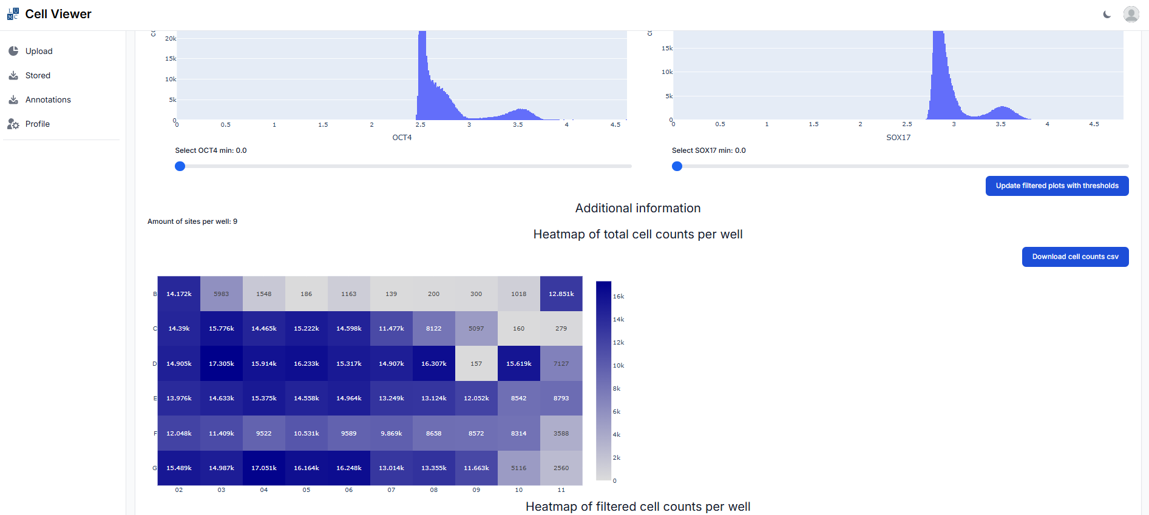
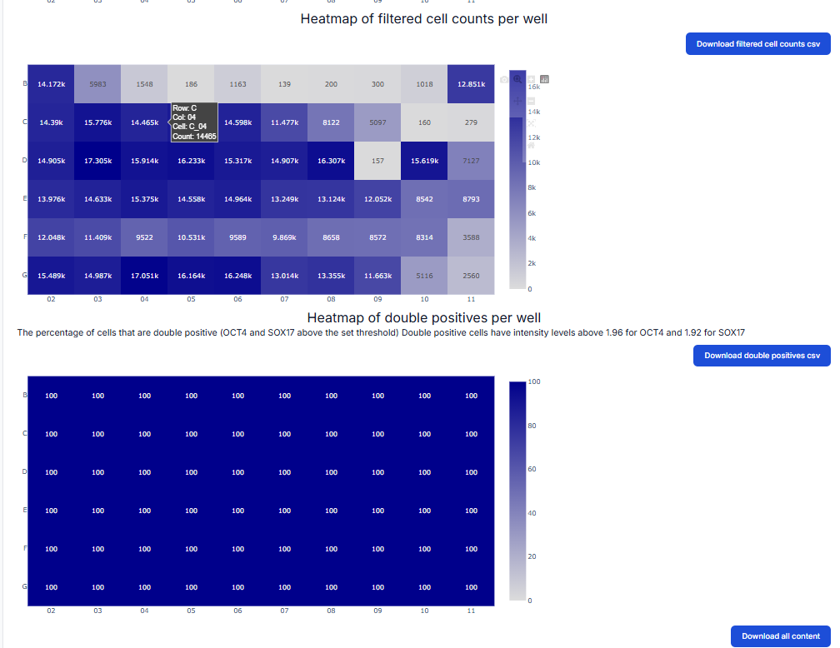
A new appearance
A professional design
Advanced navigation

Slide 14
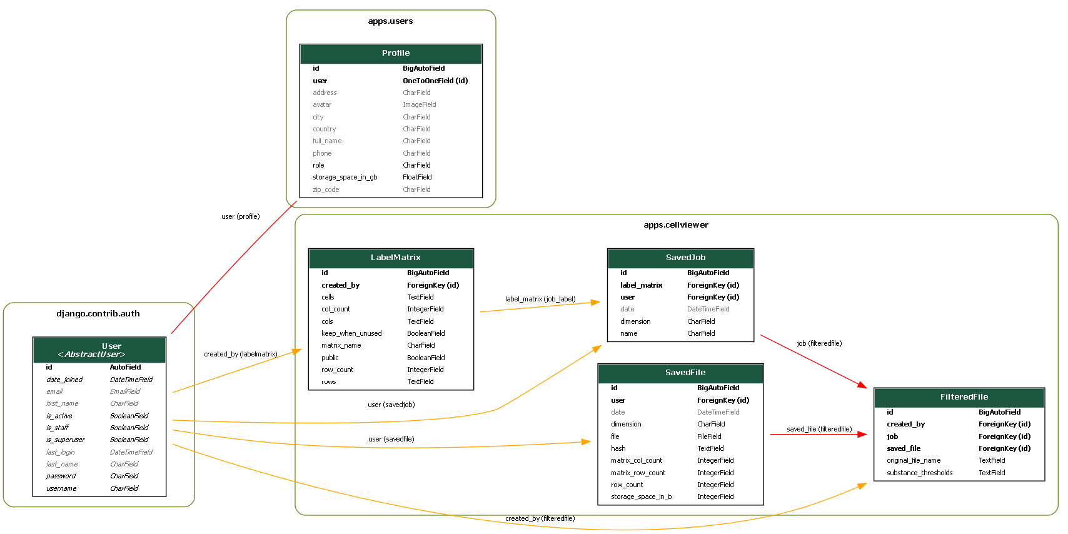
Database
Files
Experiments
Metadata
User info

Slide 15
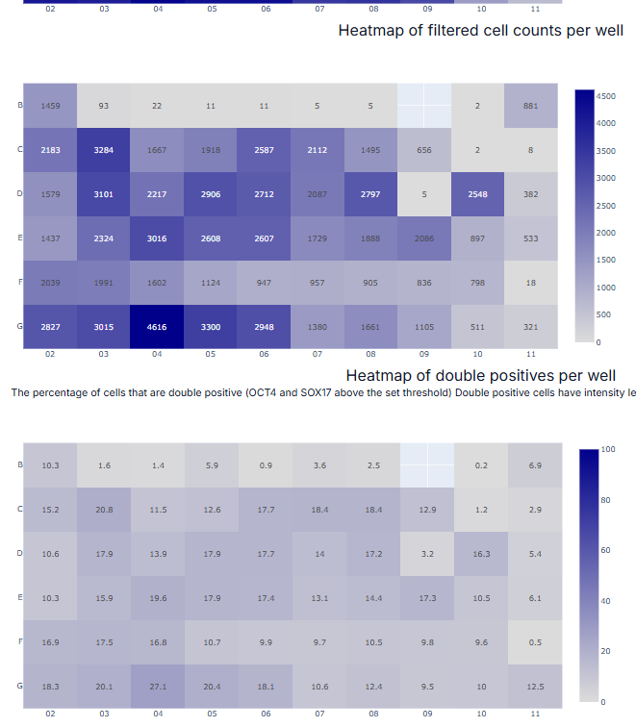
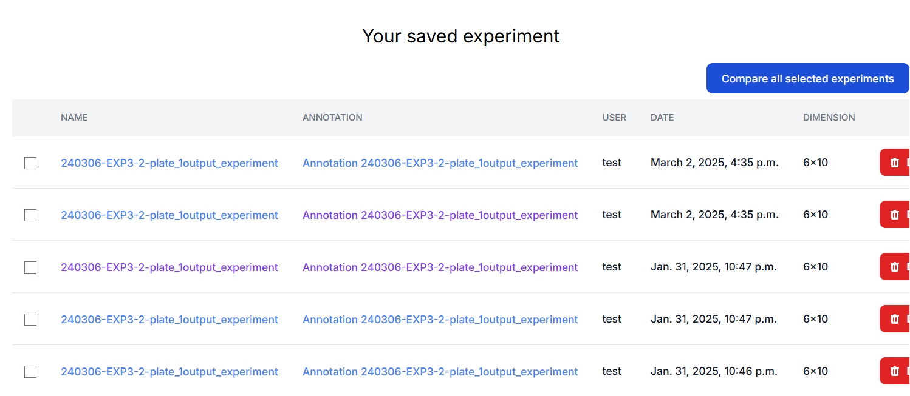
Stored experiments
Tracks metadata, e.g. Annotation, date
Stores set intensity thresholds
Loads fast
A preloaded example

Slide 16
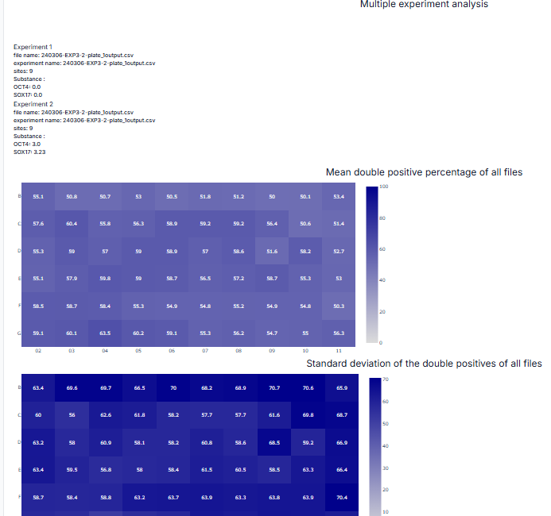

Replicate comparison
Any amount of experiments
Double positive rate
Stats
Mean
Standard deviation
N-1 if N < 30
N if N >= 30

Slide 17
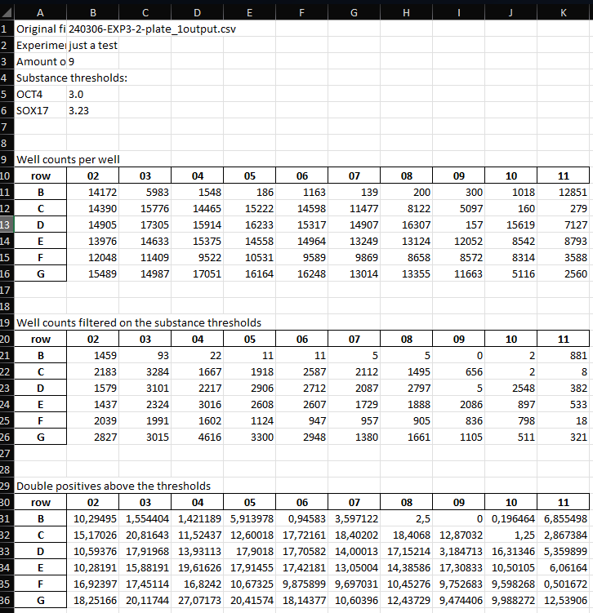
Exporting data
Important for follow up analysis
A formatted xlsx
Individual experiment
Replicate comparison

Slide 18
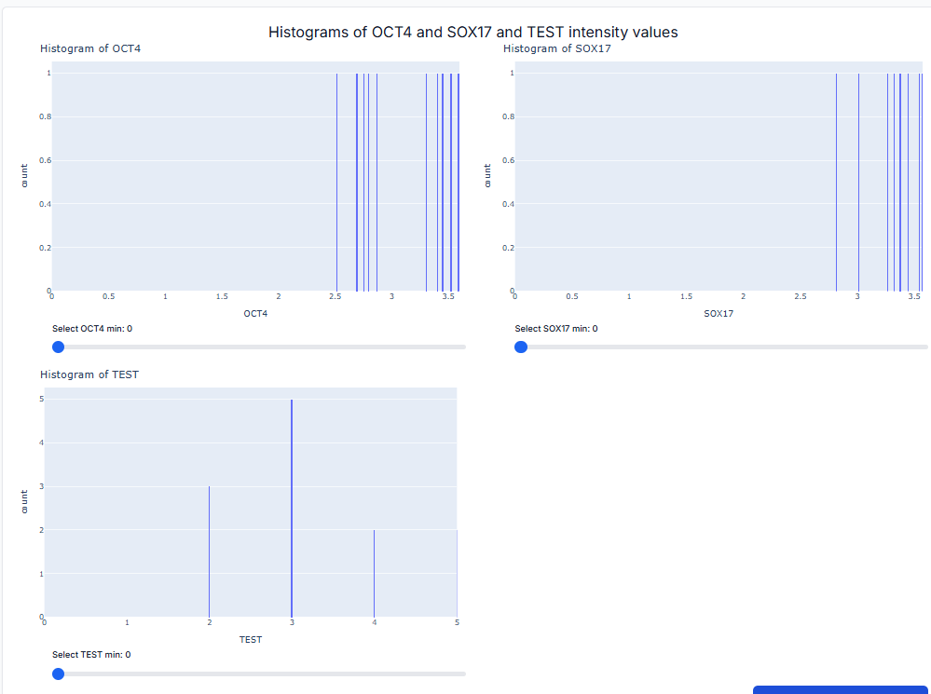



Additional notes
Data is verified
Works with any amount of channels
Added numbers to the heatmap
Extensive labelling
Database
Input files are stored as a plain text file
Storage is capped per user
Duplication of files gets avoided
Permissions
Authentication required
Users can see other’s experiments
Notes:
Channels refers to the different intensities that get measured.

Slide 19
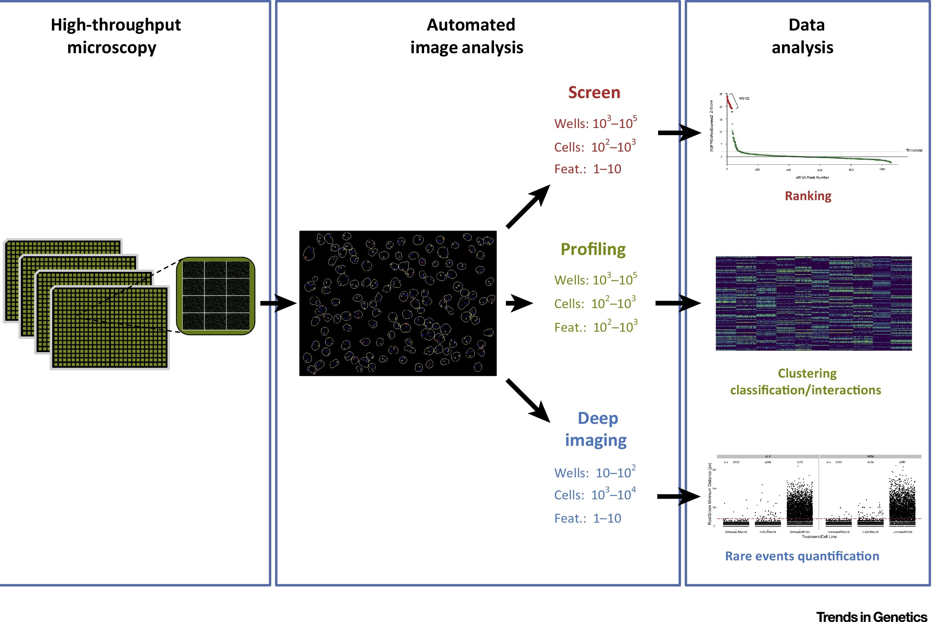
Future directions
Integrate upstream
Process raw data
Data analysis
Automated stats
More visualizations
Small additions
Usability
Customizability
More specific permissions

Slide 20
Ioannis Moustakas
Leon Mei

